Slide 1

Analyzing Toronto's 311 Service Requests
This presentation analyzes the 311 Service Requests dataset from the City of Toronto's Open Data Portal. The dataset includes various non-emergency service requests, such as road maintenance, waste management, and noise complaints. This analysis aims to explore common service requests, identify seasonal trends, and assess the efficiency of responses.
By: Muhammad Umer
To: Vivian Clements Edwin

Slide 2
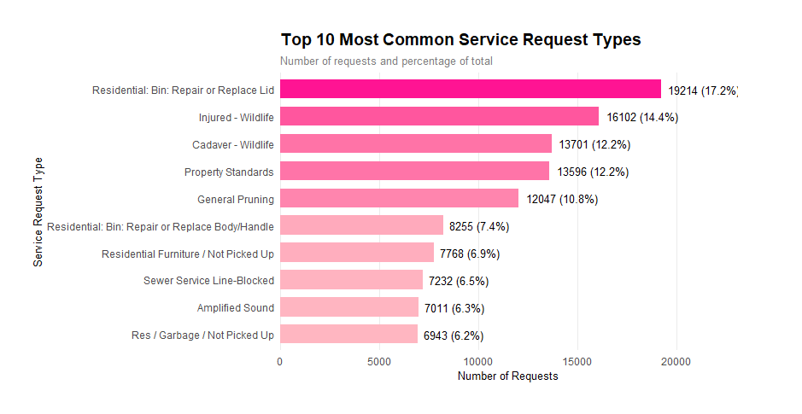
Top 10 Most Common Service Requests
Waste Management
Wildlife Encounters
Residential bin services, with 19,214 requests, represent the most frequently reported issue.
Injured and deceased wildlife, with 16,102 and 13,701 requests respectively, highlight urban interactions with wildlife.

Slide 3
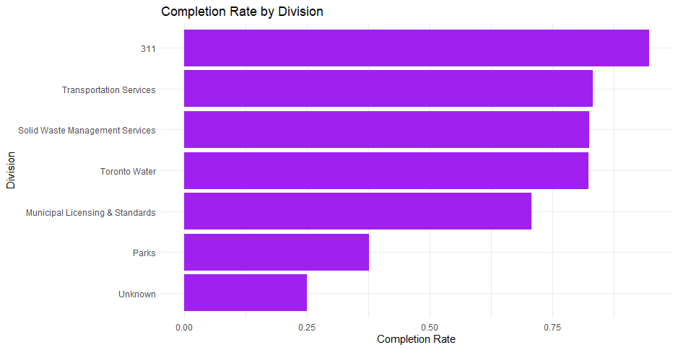
Service Efficiency by Division
311 Service
The 311 Service Division has the highest completion rate, showcasing efficient service handling.
Transportation Services
Transportation Services and Solid Waste Management have high completion rates, indicating well-functioning operations.
Challenges
Municipal Licensing & Standards and Parks have lower completion rates, indicating potential resource challenges.

Slide 4
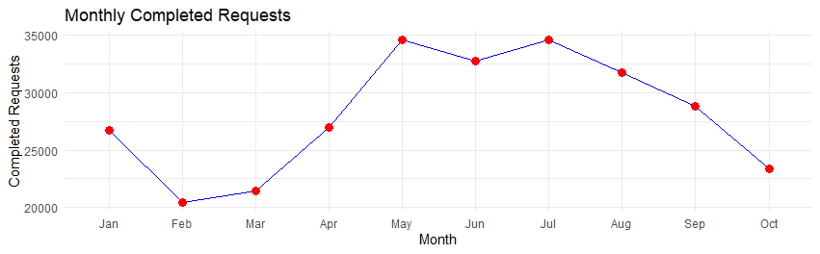
Seasonal Trends in Requests
1
The peak of service requests occurs during the summer months (June to August), with a high point in July.
2
The winter months (December to February) have significantly lower request volumes, likely due to reduced outdoor activity.
3
This pattern highlights the importance of allocating resources effectively during peak seasons.

Slide 5



Statistical Analysis: Seasonal Comparison
Hypothesis Testing
1
The analysis found a statistically significant difference in the mean number of daily service requests between the summer and winter seasons.
Interpretation
2
This suggests a systematic seasonal effect on service demands, with higher volumes during summer due to increased outdoor activity, longer daylight hours, and vegetation-related needs.
Implications
3
The findings emphasize the need for resource allocation and planning to address the higher and more variable demand during the summer months.

Slide 6
Statistical Analysis: Population Density
Ward Variations
1
There is significant variation in service request volumes across wards, with several wards showing noticeably higher or lower demand than the city-wide average.
Statistical Significance
2
The statistical analysis, however, did not find statistically significant differences in ward-level service requests compared to the city-wide average.
Implications
3
This suggests that current resource allocation strategies may be appropriate, but deeper analysis of specific wards could reveal local needs and disparities.

Slide 7
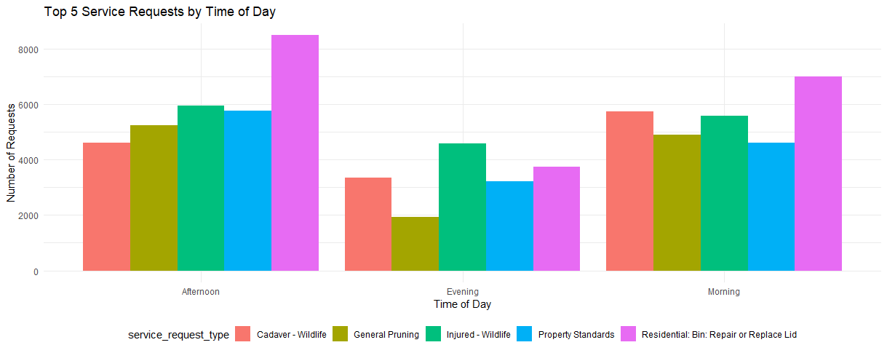
Statistical Analysis: Time of Day
1
Residential Bin
Residential bin services see peak demand in the afternoon.
2
Wildlife
Wildlife-related calls have distinct patterns between morning and evening.
3
Property Standards
Property Standards issues remain relatively stable throughout the day.

Slide 8
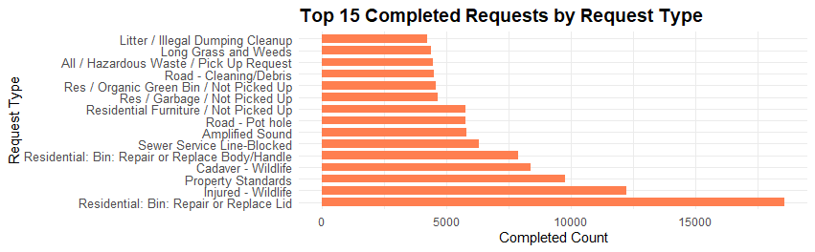


Regression Analysis: Service Request Types
Significant Impact
Temporal Patterns
Regression analysis confirmed that the type of service request significantly impacts the completed request count.
Different request types exhibit distinct temporal patterns, highlighting opportunities for time-based scheduling adjustments.

Slide 9
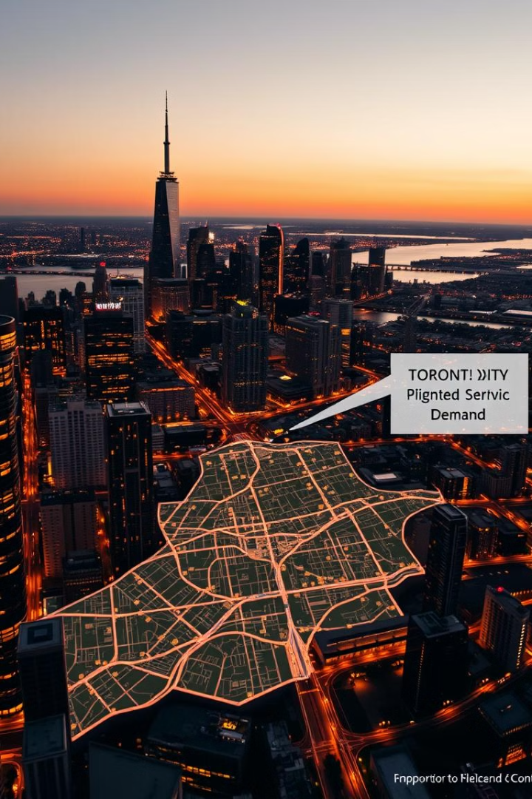
Conclusion and Recommendations
This analysis provided valuable insights into service demands, efficiency, and areas for improvement. Key recommendations include: seasonal resource planning, time-based scheduling, ward-level customization, and operational adjustments by request type. These recommendations aim to enhance citizen satisfaction while optimizing resource utilization.

